Slide 1

Building Language Literacy Skills in Mathematics
Frank Jamison
ITL522: Content Area Literacy
Professor Mark Powell
January 14, 2024

Slide 2

Instructional Strategies for High School Mathematics
Analyzing Instructional Strategies for Accessing Informational Text

Slide 3

Vocabulary Building in Context
Mathematics has its own unique set of terminologies that can be challenging for students. One strategy is to integrate vocabulary lessons into the study of mathematical concepts. This can be done by creating glossaries of terms, using words in context during problem-solving, and having students create their own definitions or usage examples. It's also beneficial to highlight how certain words might have different meanings in a mathematical context compared to everyday use.

Slide 4

Graphic Organizers for Conceptual Understanding
Graphic organizers such as Venn diagrams, flowcharts, and concept maps can help students understand and retain complex mathematical concepts and their relationships. For example, when reading a text about a specific mathematical theory or formula, students can use these tools to organize information, illustrate processes, or compare and contrast different methods or ideas. This visual representation aids in comprehension and retention of technical content.

Slide 5

Textual Analysis with a Mathematical Lens
Teach students to critically analyze mathematical texts, focusing on understanding the author's purpose, the structure of arguments, and the evidence provided. This strategy includes examining how theorems are proven, how data is presented, and how conclusions are drawn. Encouraging students to question and discuss the text helps deepen their understanding and promotes critical thinking skills.

Slide 6

Problem-Based Learning (PBL)
This approach involves presenting students with real-world problems and guiding them through the process of finding solutions using mathematical concepts. In PBL, informational texts can be used as a resource for background information, data, and examples. This method not only improves literacy as students must read and understand complex texts but also enhances their ability to apply mathematical knowledge in practical situations.

Slide 7

Planning a School Event
Writing Assessment: Applying Mathematical Vocabulary in Context

Slide 8
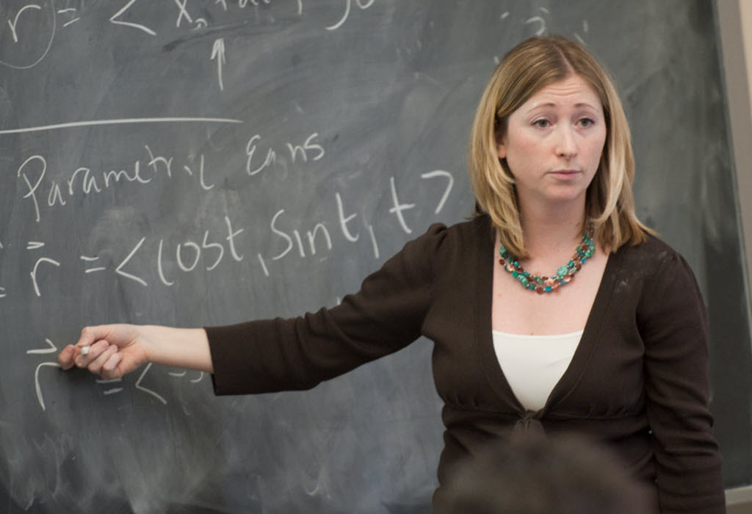
Instructions
Read the Scenario: You will be provided with a real-world scenario that involves mathematical concepts. Carefully read the scenario to understand the context and the mathematical problem presented.
Identify and Apply Vocabulary: In your response, identify and apply at least five mathematical terms or concepts from the vocabulary lessons. These terms should be relevant to the scenario and help in solving the mathematical problem.
Problem-Solving: Using the identified vocabulary, solve the mathematical problem presented in the scenario. Show your step-by-step solution, calculations, and explanations.
Explain in Plain Language: After solving the problem, explain the solution in plain language. Imagine you are teaching this concept to someone who is not familiar with mathematics. Use your own words to clarify and simplify the solution.

Slide 9

Scenario: Planning a School Event
You are part of a student committee responsible for planning a school event. Your task is to manage the event’s budget and ensure that expenses are within the allocated funds. You will need to apply your knowledge of algebraic concepts to solve budget-related problems.
Scenario Details:
Budget Allocation: The school has allocated a total budget of $1,500 for the event.
Expenses: You have a list of potential expenses for the event, including:
Venue rental: $500
Decorations: $200
Food and drinks: $300
Entertainment: $400
Budget Adjustment: You have received additional funding of $300 from a sponsor.

Slide 10
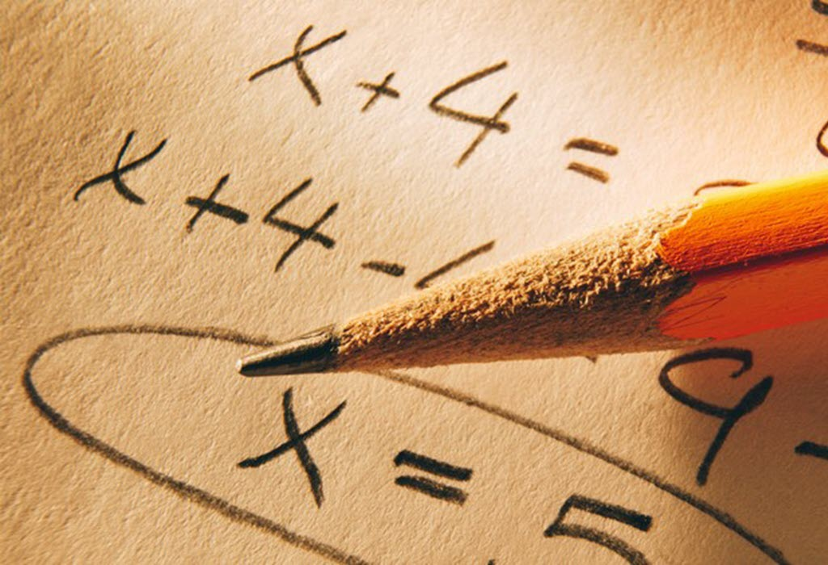
Your Tasks
Identify Variables: In your response, identify and define the variables that you will use to solve the budget-related problems.
Problem-Solving: Use algebraic expressions and equations to calculate the remaining budget after deducting expenses and adding the sponsor's funding.
Explanation in Plain Language: After solving the problems, explain your solutions in plain language to ensure that the rest of the committee members understand the financial situation for the event.

Slide 11

Assessment Criteria
Application of Vocabulary: Effective use of at least five relevant mathematical terms or concepts from the vocabulary lessons.
Problem-Solving Skills: Accuracy and clarity in solving the mathematical problem.
Communication: Clear and concise explanation of the solution in plain language.
Content Comprehension: Demonstrated understanding of mathematical concepts in a real-world context.
Literacy Skills: Effective use of vocabulary and grammar in the explanation.

Slide 12

Assessing Literacy Levels and Ability Grouping
Categorizing Students for Targeted Instruction

Slide 13

Group 1: Proficient Writers
Strengths:
Accurate Application of Vocabulary: Proficient writers effectively incorporate mathematical vocabulary into their responses.
Clear and Coherent Explanations: They provide clear and coherent explanations in plain language, ensuring that their solutions are easily understandable.
Accurate Problem Solving: They demonstrate accuracy in solving mathematical problems using algebraic expressions and equations.
Areas for Improvement:
Complexity of Problem Solving: Encourage these students to tackle more complex mathematical scenarios that require advanced algebraic concepts.
Vocabulary Depth: Expand their mathematical vocabulary by introducing advanced terms and concepts.

Slide 14
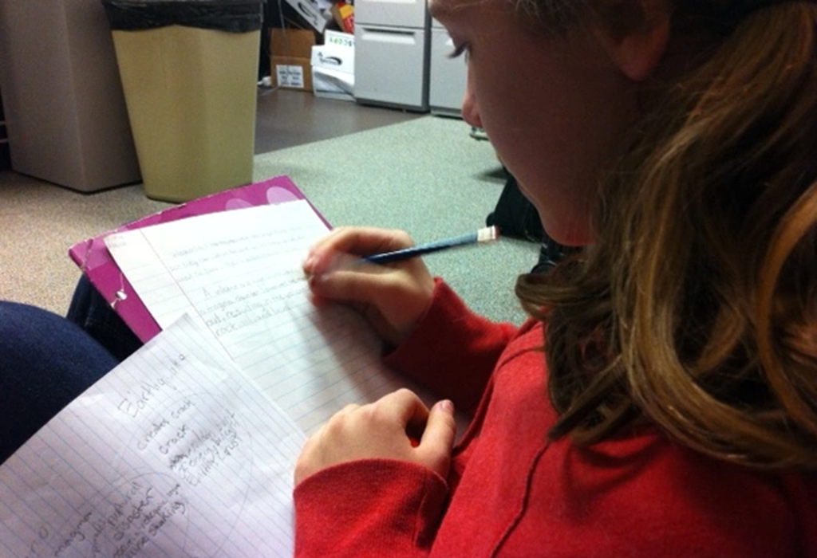
Group 2: Developing Writers
Strengths:
Basic Vocabulary Application: Developing writers show an understanding of fundamental mathematical vocabulary and can apply it to some extent.
Partial Clarity: They attempt to explain solutions in plain language, but there may be some areas of confusion.
Areas for Improvement:
Vocabulary Expansion: Focus on building their mathematical vocabulary further to include more terms and concepts.
Clarity and Coherence: Provide guidance on improving the clarity and coherence of explanations.

Slide 15

Group 3: Novice Writers
Strengths:
Effort and Engagement: Novice writers show effort and engagement in attempting to apply mathematical vocabulary.
Basic Problem Solving: They make an effort to solve mathematical problems but may have accuracy issues.
Areas for Improvement:
Fundamental Vocabulary Mastery: Continue to work on fundamental mathematical vocabulary.
Problem-Solving Skills: Provide additional support to enhance their problem-solving accuracy.
Clarity in Explanations: Focus on improving the clarity of explanations, even if basic.

Slide 16
Assessment Rubric
 | Developed | Emerging | Initial
Content (5 points) | 6-10 points Proficient understanding and accurate application of mathematical vocabulary. | 3-5 points Partial understanding with some accuracy in applying vocabulary. | 0-2 points Limited understanding of mathematical concepts and vocabulary.
Problem-Solving (3 points) | 3 points Accurate problem-solving using algebraic expressions and equations. | 2 points Partially accurate problem-solving. | 0-1 points Inaccurate problem-solving or no attempt.
Clarity of Explanation (2 points) | 2 points Clear and coherent explanations in plain language. | 1 point Some clarity in explanations, but areas of confusion exist. | 0 Points Lack of clarity and coherence in explanations, making it difficult to understand.

